Slide 1

Basic Visualization Tool

Slide 2
Objectives
Explain how to generate an area plot using Matplotlib
Describe why and how to create histograms using Matplotlib
Explain how to create bar charts
Basic Visualization Tool

Slide 3
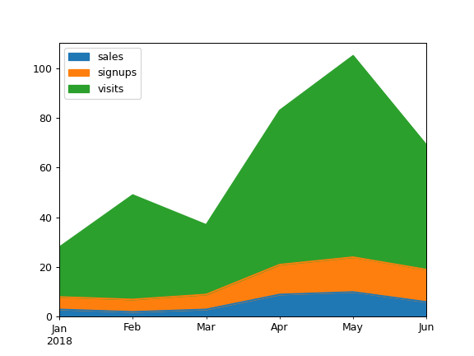
Area Plots
What is an area plot?
  An area plot also known as an area chart or area graph.
  It depicts accumulated totals using numbers or percentages over time.
  It is based on the line plot and is commonly used when trying to compare two or more quantities.
Basic Visualization Tool

Slide 4
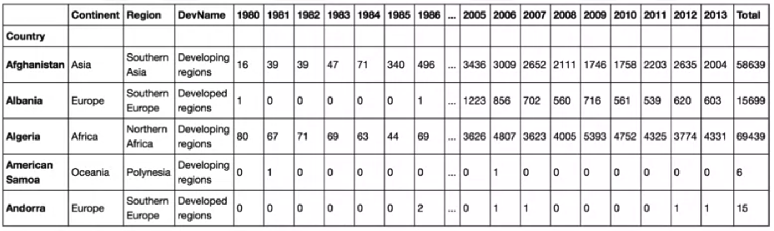
Area Plots
Processed dataset
  Process the dataframe so that the country name becomes the index of each row.
  Add an extra column which represents the cumulative sum of annual immigration from each country from 1980 to 2013.
Basic Visualization Tool

Slide 5
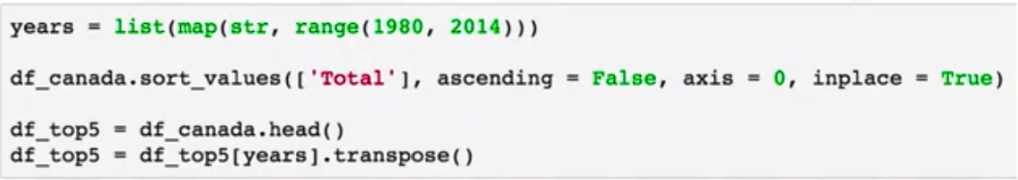

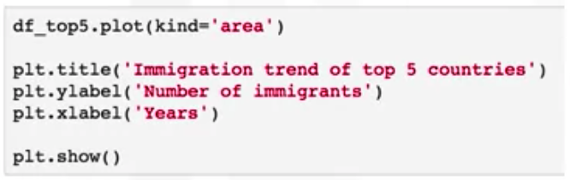
Area Plots
Question: generate area plots for the countries with the highest number of immigration to Canada.
Basic Visualization Tool

Slide 6
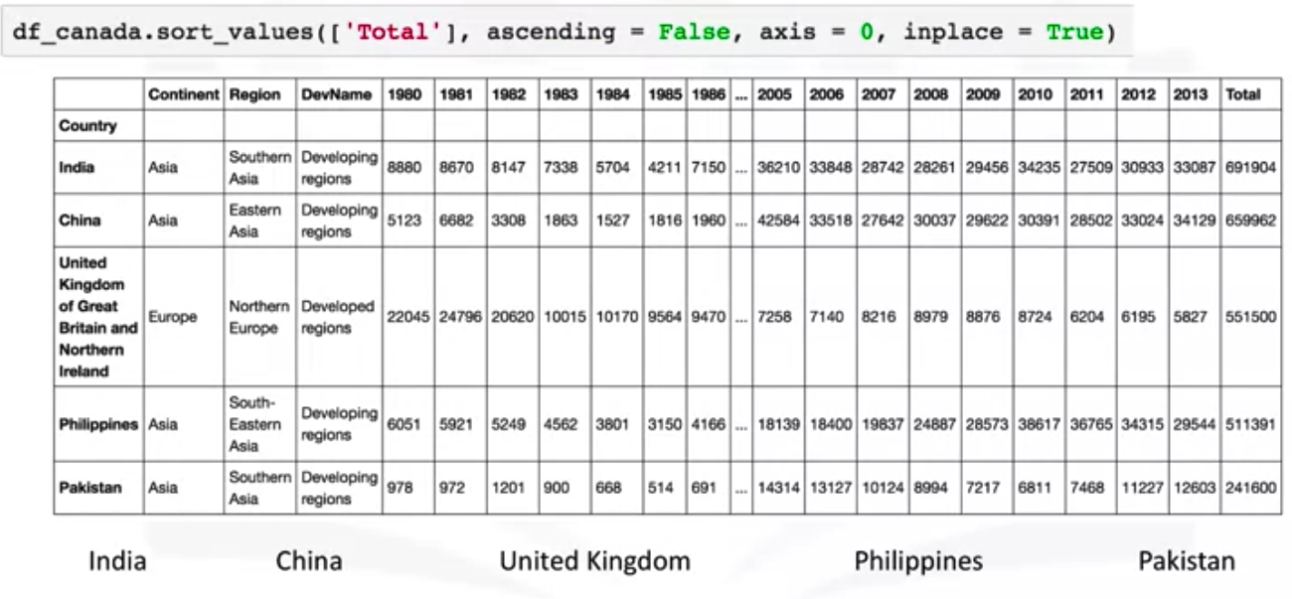
Area Plots
Basic Visualization Tool

Slide 7
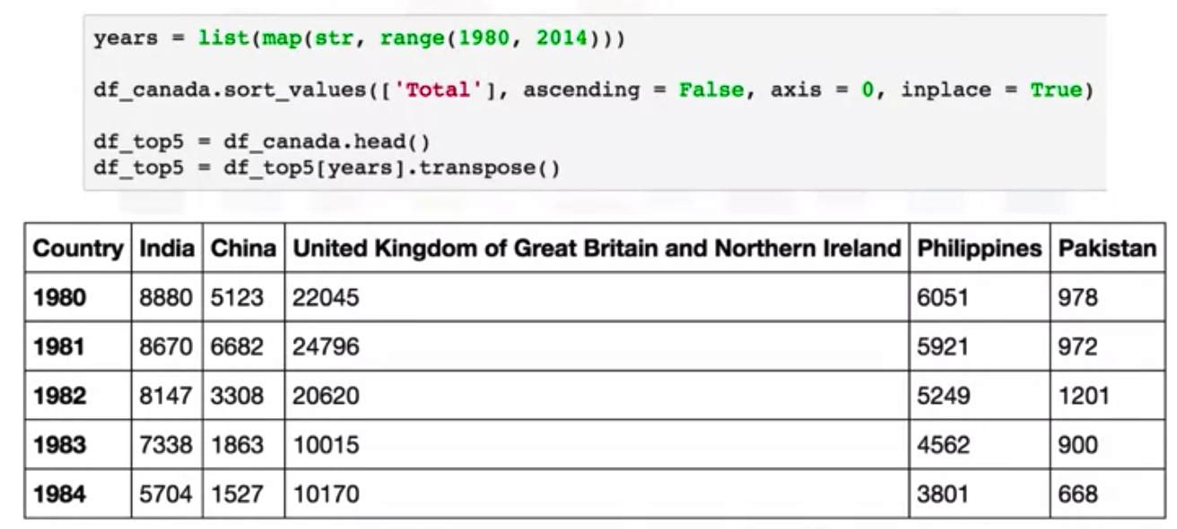
Area Plots
Basic Visualization Tool

Slide 8
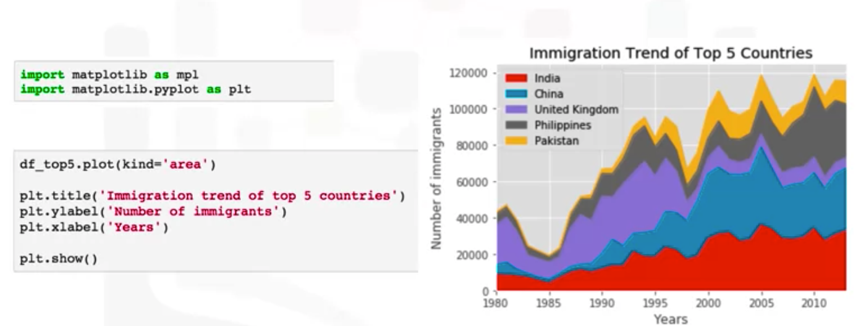
Area Plots
Basic Visualization Tool

Slide 9
Histograms
A histogram is a way of representing the frequency distribution of a numeric dataset.
Flow:
  It partitions the spread of the numeric data into bins
  Assigns each data point in the dataset to a bin
  Then counts the number of data points that have been assigned to each bin.
The vertical axis is actually the frequency or the number of data points in each bin.
Basic Visualization Tool

Slide 10
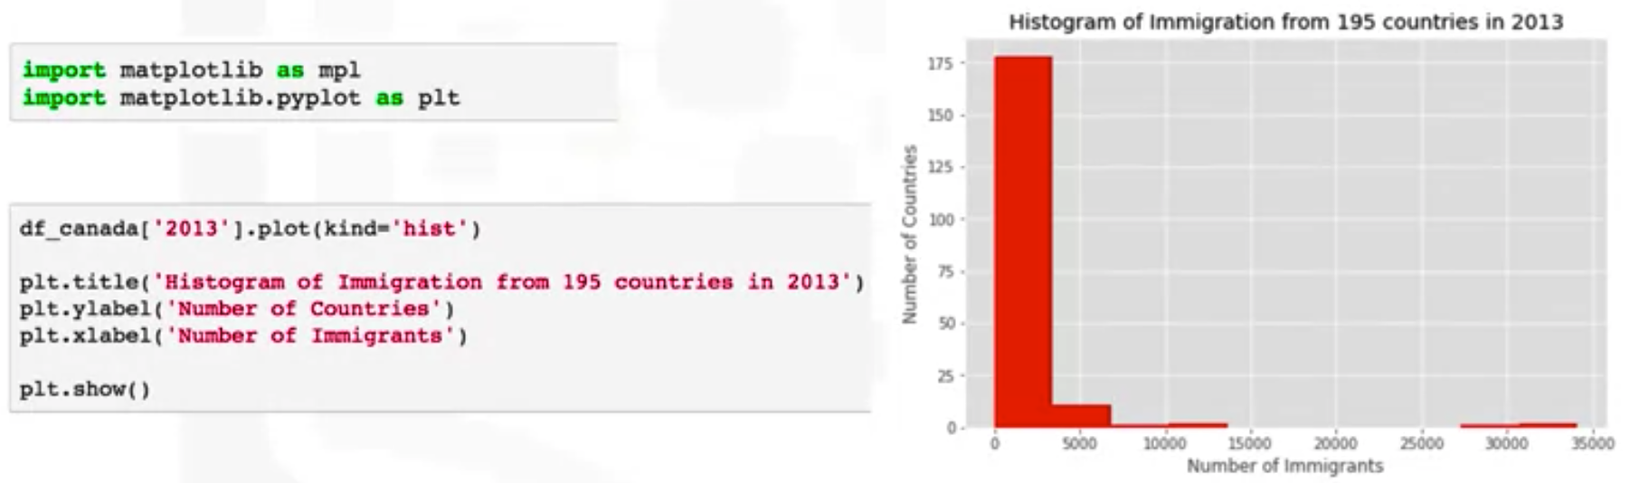
Histograms
A histogram that depicts the distribution of immigration to Canada in 2013
Basic Visualization Tool

Slide 11
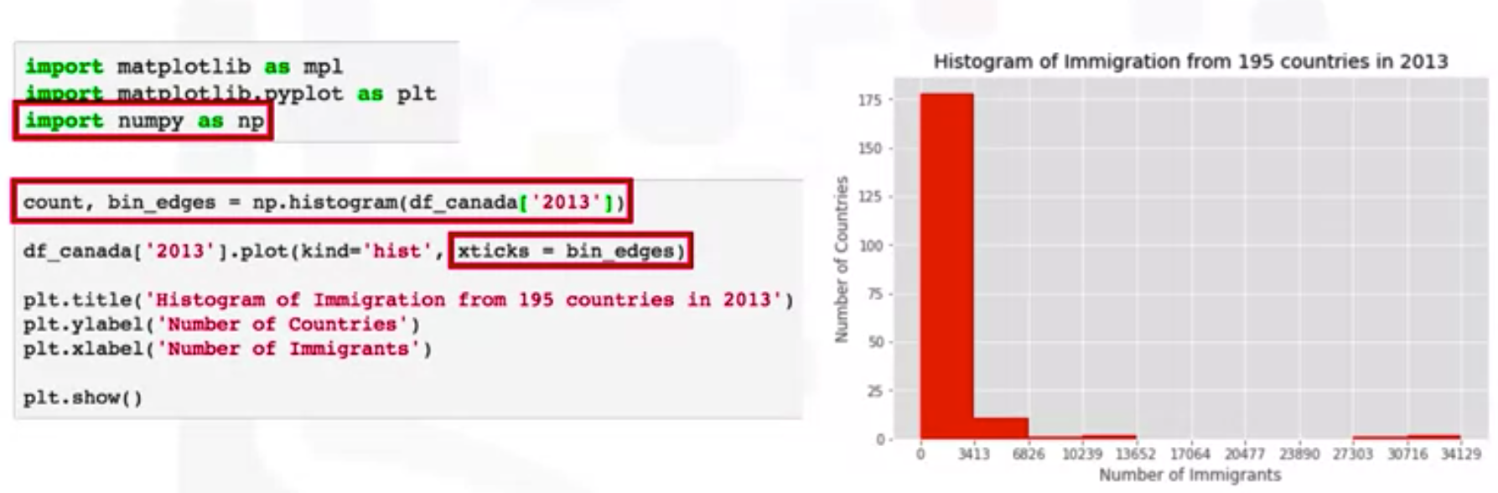
Histograms
Topic11111
Basic Visualization Tool

Slide 12
Bar Charts
A bar chart also known as a bar graph is a type of plot the length of each bar is proportional to the value of the item that it represents.
It is commonly used to compare the values of a variable at a given point in time.
For example, say we're interested in visualizing in a discrete fashion how immigration from Iceland to Canada looked like from 1980 to 2013.
Basic Visualization Tool

Slide 13
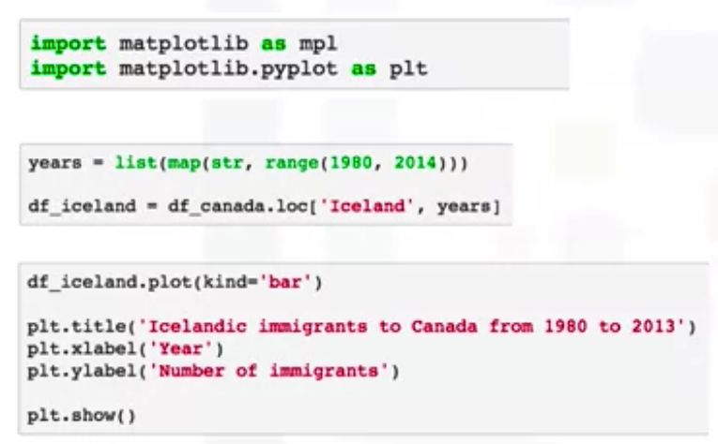
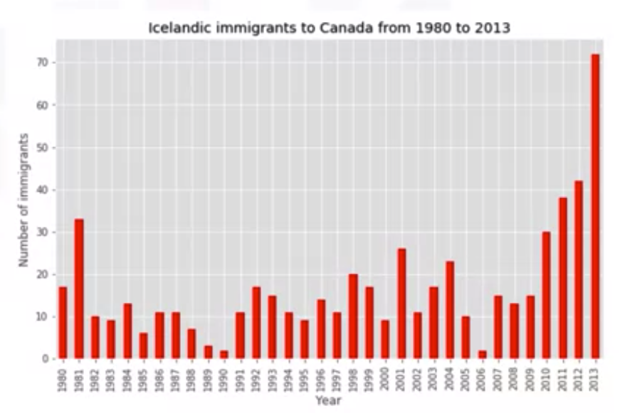
Bar Charts
Icelandic immigrants to Canada from 1980 to 2023
Basic Visualization Tool

Slide 14
Summary
Explain how to generate an area plot using Matplotlib
Describe why and how to create histograms using Matplotlib
Explain how to create bar charts
Basic Visualization Tool

Slide 15
Q & A
Basic Visualization Tool

